Slide 1
Maitahi Bayview
Oral Submission Bill Gilbertson

Slide 2
Planning requirements – Cycling as active transport
National Policy Statement on Urban Development Capacity 2020
2.2 Policies Policy 1 (c) have good accessibility for all people between housing, jobs, community services, natural spaces, and open spaces, including by way of public or active transport.
NRPS EN1.4.2 Council will establish cycle routes through the urban area in order to provide for safe and convenient cycling
NRPS IN2.4.5 Council will make provision for pedestrian access, walkways, cycleways where appropriate, and where possible provide physical separation from other road users, sufficient lighting and an appropriate surface.

Slide 3
Application
From report by Traffic Concepts they expect cycling to be
Bayview rd – 8% cycle useage Current nelson usage is 6.1%
Maitai Rd 20% cycle useage
Climate change -”Turning to the matter of carbon emissions, the very close proximity of this site to the City Centre, and opportunity for alternative/active transport modes to be utilised, also provides potential positive outcomes”
NZTA- “Concentrating development around existing areas and intensifying could reduce vehicle trips and increased active transport mode share.”

Slide 4
Is this a reality ?
What actually happens in Nelson?
Do we design for cyclists?

Slide 5
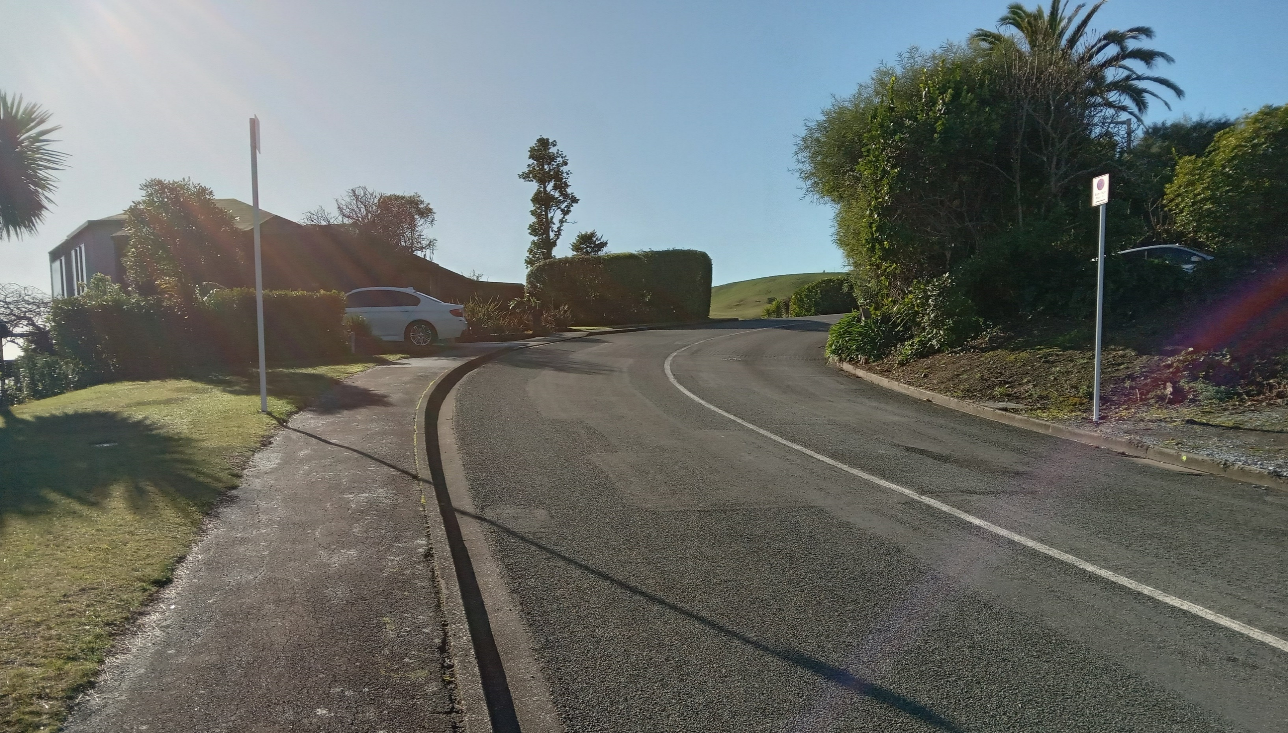
Bayview Road 8% Cycles and 1575 vehicles /day

Slide 6
Standard – do we have any to draw on for this?
There are two main standards to draw on for design of cycleways/shared paths in NZ
AUSTROADS
NZ CYCLE TRAIL DESIGN GUIDELINE

Slide 7
What do these standards have to say?
Gradient– Both state that for desirability and correspondingly usage, gradients over 5% need to be restricted in length. Ideal gradients are <3%
Safety- Traffic movements of over 1000/day at 50km/hr require either off road facilities or on road dedicated cycle lanes or wide shoulders.
Width and surface are also covered

Slide 8
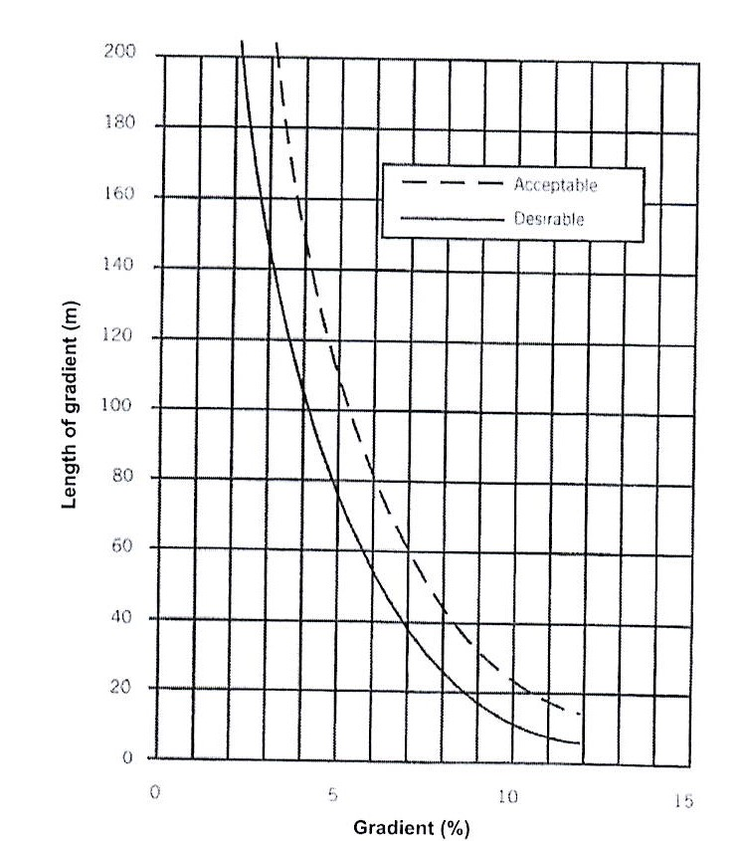
AUSTROADS extract
3% slope 200+m
10% slope
max distance 20m

Slide 9
Bayview rd 10% slope 1.5m footpath, no cycle lanes

Slide 10
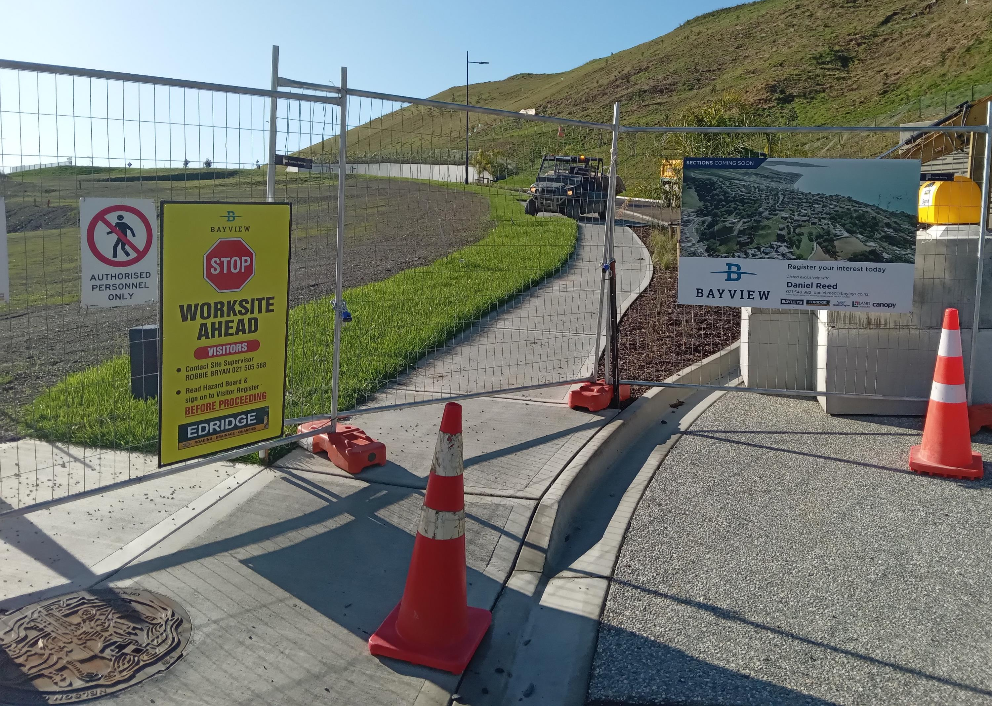
New subdivision Bayview
1.5m footpath
No cycle way or lanes

Slide 11
Cycle access into the Maitai for this development
The applicant has stated
The hierarchy of walking and cycling routes has not been developed at this stage and will form part of the subdivision process.
This would follow the land development manual –
Unfortunately this document is inadequate in providing desirable and thus usable commuter cycling routes.
It is likely that a road would be similar to Bayview rd

Slide 12
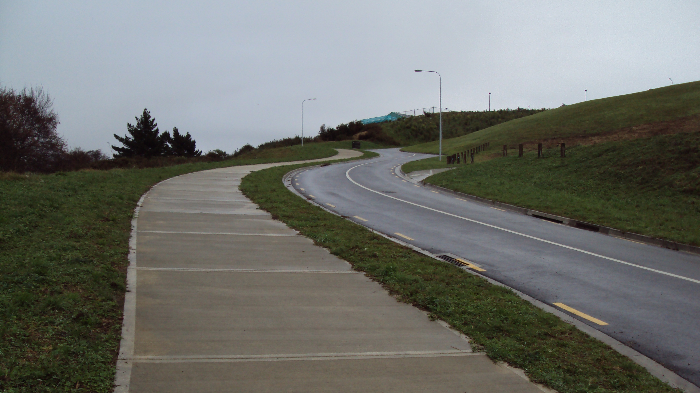
Oceanview access 8-10% gradient

Slide 13
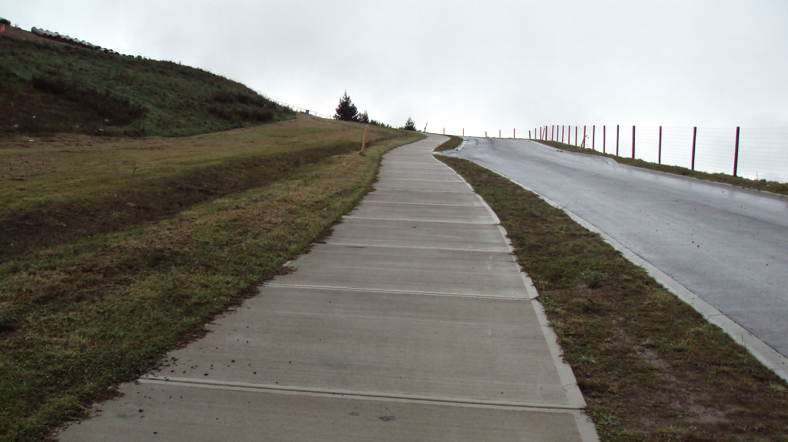
Oceanview to new cycleway link 11% gradient

Slide 14
Why do we not design for cycleways?
The Land development manual is inadequate. It doesn’t attend to the issue of to providing for safe and convenient cycling despite policies stating that it is required.
National standard planning standards for cycle ways are largely ignored when designing transport routes and roads

Slide 15
Outcome sought
If cycle useage of 8 and 20% proposed by the applicant are to be achieved. (remember that Nelson is currently 6.1% )
There needs a condition on the application that
At least one dedicated cycleway/ walkway at between 3% and 5% gradient and min 3m wide created to the valley floor.

Slide 16
Climate change actions
This application champions the subdivision having higher density and being close to town and being good for the environment. It also sets aside reserve areas.
However the thoughts on this are not wide enough. NZ is soon going to buy CO2 credits to compensate for our emissions.
NCC has declared a climate emergency- If they are serious about this then they need to consider all actions in the city.

Slide 17
Carbon footprint of the subdivision – rough figures
750units at 15-30 tonnes CO2 /house = 16,875 tones CO2
20km roading at 1tonne/m = 20,000 tones CO2
Total 36,875tonnes CO2
The only method we have at the moment for direct compensation is planting forest
300 tonnes/ha at maturity 123ha (Default tables ETS)
DIscount can be allowed for existing direct construction materials CO2 allowance

Slide 18
Desired outcome
An evaluation by the applicant how much CO2 will be released by their activity.
A commitment by the applicant as to how they intend to directly compensate for this release.
Set aside the land for each household to contribute as the building is done – 0.1ha/house unit

Slide 19
Thank You

